Slide 1
Starting at 12:05 PM!
Until then, enjoy the music and turn on your camera if you can!

Slide 2
Tutorial 05
COVID-19 Data Project

Slide 3
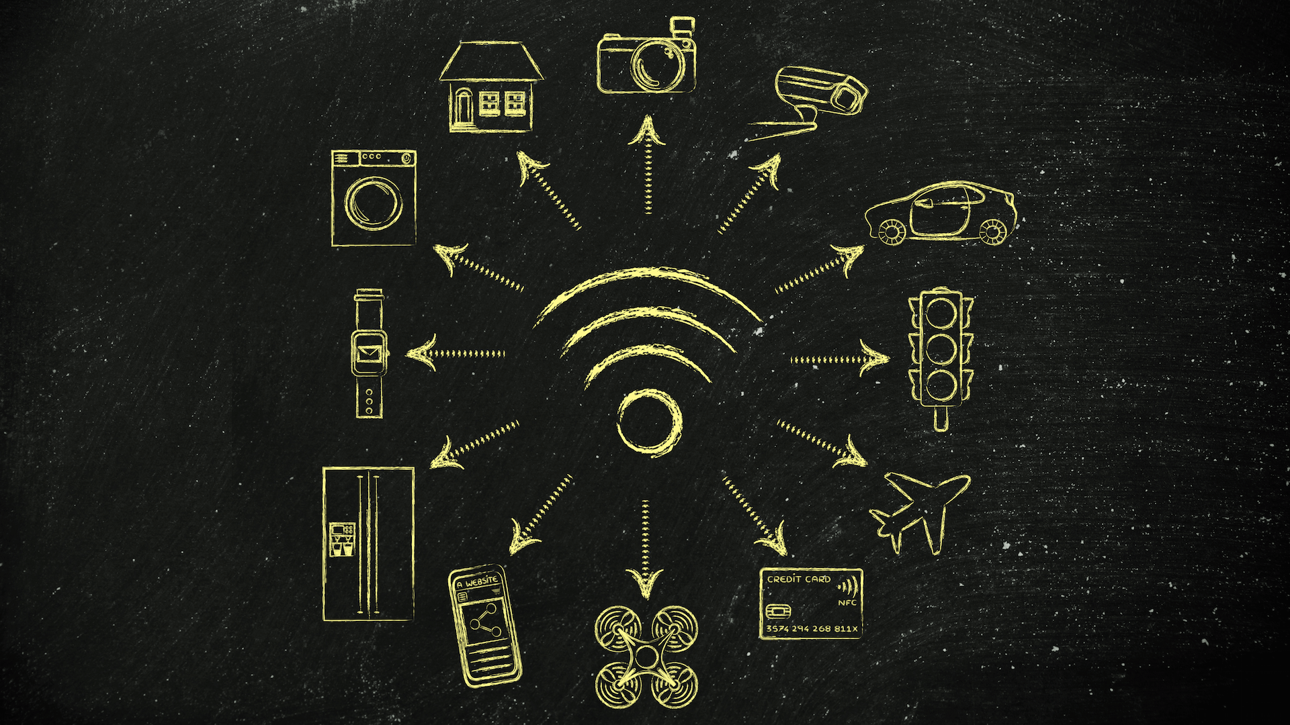
Breaking the Illusion!
Have you ever considered how two devices or services can “talk” to each other? For example, how does an Alexa control the lights in your home? How can a Roomba show notifications on your phone? Even more simply, how can Slack coordinate with Google Calendar? They are two entirely two different companies!
You may have heard of the Internet of Things, a web that connects all of our devices. But what is this “web” of connections? How does it work? How can we, as developers, access this incredibly vast pool of information?
Notes:
No code for today

Slide 4
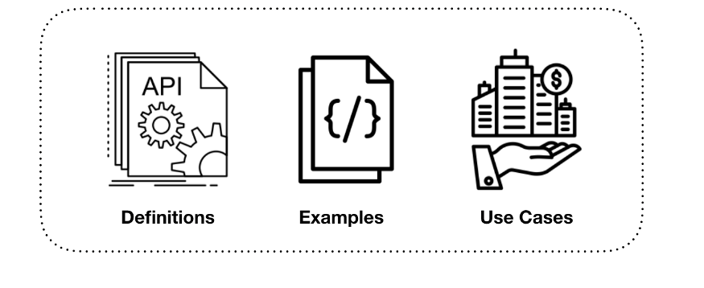
Rarity (or lack thereof…)
Every single company uses an API. Here are some examples!
Google
Netflix
Slack
Facebook
Walmart
Microsoft
Any company you can ever list…..
Even we use API’s! Technically, you’ve already been doing so!

Slide 5

When/Where Do I Use Them?
Quite literally everywhere!
Companies and consumers people use the Skyscanner API to find out the price and availability of flights at a given time, people use the Flickr API to automatically find relevant images to go with their articles, people use the Cronofy API to organise people’s schedules and the bookable resources for their organisation.
Healthcare providers use them to securely and effectively communicate data to other organizations and administrators
You use them every time you login in to any platform! Ever thought of how and where your passwords are stored? How they’re encrypted? Hint: API’s!
You use them every time you book anything on the internet, be it a flight, tickets to the Nets games, whatever have you!
Ever used a credit card to pay for something, online or otherwise? You guessed it: API’s!

Slide 6

Restaurants and Bridges
You may have guessed already that it has something to do with an API or an Application Programming Interface. But what is an API? How do we conceptualize it? As an analogy, let’s talk about restaurants and bridges (we promise this has something to do with something!).
Notes:
https://blog.usejournal.com/part-1-gentle-introduction-to-apis-for-non-technical-people-what-is-it-fde4d97a3083
https://medium.com/apinf/apis-for-non-techies-like-myself-259f60042ba

Slide 7
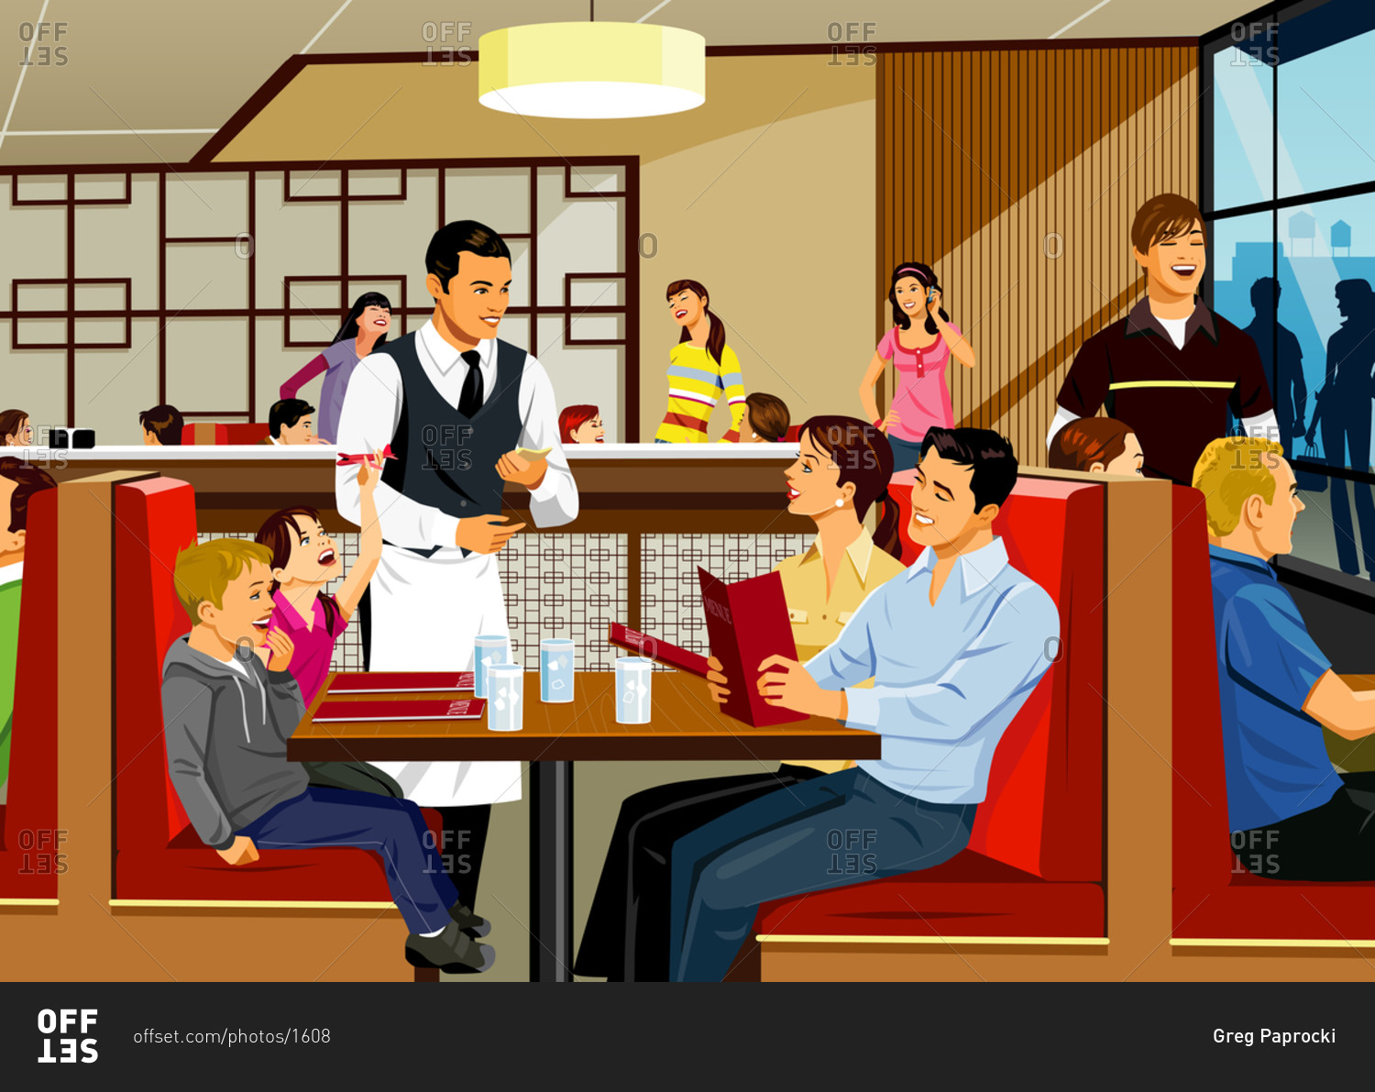
Ordering At A Restaurant
When going to a restaurant, as a customer, you’re not allowed to go into the kitchen. To know what is available, you have to look at the menu.
After looking at the menu, you place your order with the waiter.
The waiter passes it to the kitchen, which then processes your order and hands it off to the waiter, who brings it to your table. The waiter can only provide what the kitchen provides.
This, in the most basic sense, is how an API works!
Can you guess who the API is in this scenario?

Slide 8
Analogies, Analogies...
In the scenario we just discussed, the API would be the waiter.
The consumer (you!) is an API customer.
The menu is the documentation of the API and defines what you can or cannot request (for example, it doesn’t make sense to order a car from a bodega).
The kitchen would be a server, a database or some other processing unit that returns the data (or “food”) that you requested.
In order to get the data (or “food”) that you want, you need to make a request (place an order) in a specific way (defined by the menu) with the API (the waiter). If you make a request in the wrong way, you won’t get what you want.

Slide 9
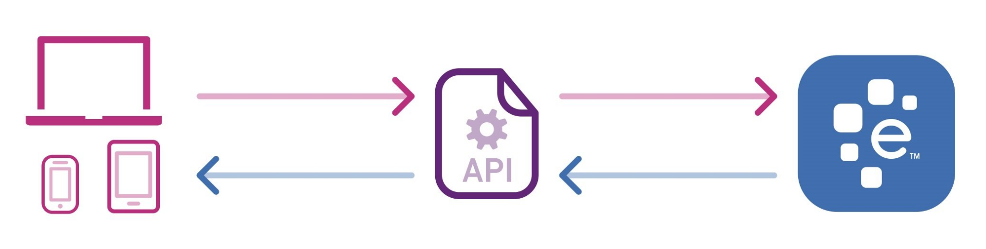
Continued...
Now then, can you guess what an API is?
An API is simply a way for two programs to be able to “talk” to each other. One program requests some information from some sort of database, which will return some data if the request was placed in the right way. (Ex: You will only receive your order from the kitchen if you select something from the menu.)
API’s can also send commands to each other which is how you can schedule a Google Calendar Event straight from Slack! It’s just a matter of sending the right data!

Slide 10
One Last Explanation...
An API is like a language - it enables programs to communicate with each other and to transmit information, commands or alerts.
When a company releases an API, it essentially allows the developer to access their service, thus helping the consumer to communicate with the company’s product.
“So APIs define a list of commands as well as the necessary format of those commands. When a company releases an API for their software, it means that they’ve basically told everyone: here is what you can get from our program and here is exactly how you have to ask to get it.”

Slide 11
Breaking it down even further...
Documentation
(Menu)
Program A
API
Program B
(Kitchen)
(Customer)
(Waiter)
Database
(Storeroom/Storage)

Slide 12

One Last Analogy
“[Think of] APIs as bridges. There is river, and roads on both sides of the river. For the cars to go from one side to the other, there needs to be a bridge. If you have a bridge, you may need to control the amount of traffic; only a certain number of cars can pass every hour. Since it is fairly expensive to build the bridge, you may also want to collect a toll for using the bridge. This is true for APIs as well; data traffic needs to be controlled to prevent server congestion. Charging a fee for the API enables the company to recover its costs.

Slide 13
Ok, So What?
Cool, we know what an API is. But why is it important? Why do we care?
They are used for everything (hint: slide 4)
They enable programs to communicate with each other independent of the programming language they are written in, while they abide by certain rules and restrictions. It would be impractical to have to know every single language in the world just to start coding!
You don’t have to exit your program or website to use someone else’s data. For example, your website can display weather data without the user having to go to weather.com.

Slide 14
I’m Still Not Convinced...
They reduce complexity. Could you imagine having to talk to a Google Engineer everytime you wanted to put an event on your calendar or send an email? Or how about re-engineering Alexa any time you want to ask it to add something to your shopping list?
They enable the internet of things! Think about it - how can all of the different companies in the world, with all their quirks and nuances, ever agree to work together? How can your digital assistant play music from Spotify or order something off of Amazon? How can Alexa control the lights in your house or open your garage?

Slide 15
Some Incredibly Practical Use Cases...
They’re the bread and butter of any major corporation and you will most assuredly be working with them if you decide to start a career in software development!
Knowledge of API’s and manipulating them are must have skills to display on your resume or portfolio.
API’s allow you to access the deeper level of the internet and expands your ability to create change outside of your computer. With it, you can interface with companies such as Google to perform data analysis or connect to companies like Twilio to send millions of text messages.

Slide 16
Quiz!
What is an API?
Why are API’s useful?
Where do you see API’s being used?

Slide 17
Coming Up
Request Protocols (HTTP and HTTPS)
Types of Requests (Get/Post/Delete)
API’s and Where to Find Them
Using an API [Non-Programming Edition]
Using an API [Programming Edition]

